Slide 1
Battery storage market trends in The Netherlands
EOS Kennisdag
Jaarbeurs MeetUp Utrecht,
11th November 2024
Dr Hrvoje Medarac
Team Leader and Head Researcher
Dutch New Energy Research
Jan de Wit
Team Leader and Chief Editor
Solar365 & Warmte365
h.medarac@dutchnewenergy.nl
+31 72 202 0201
jan@solar365.nl
+31 72 572 9794

Slide 2
Sustainable solutions nederland
LEGAL COMPANY
EVENTS
RESEARCH
MEDIA

Slide 3
Sustainable solutions europe
JOINT VENTURE COOPERATION
EVENTS
…

Slide 4
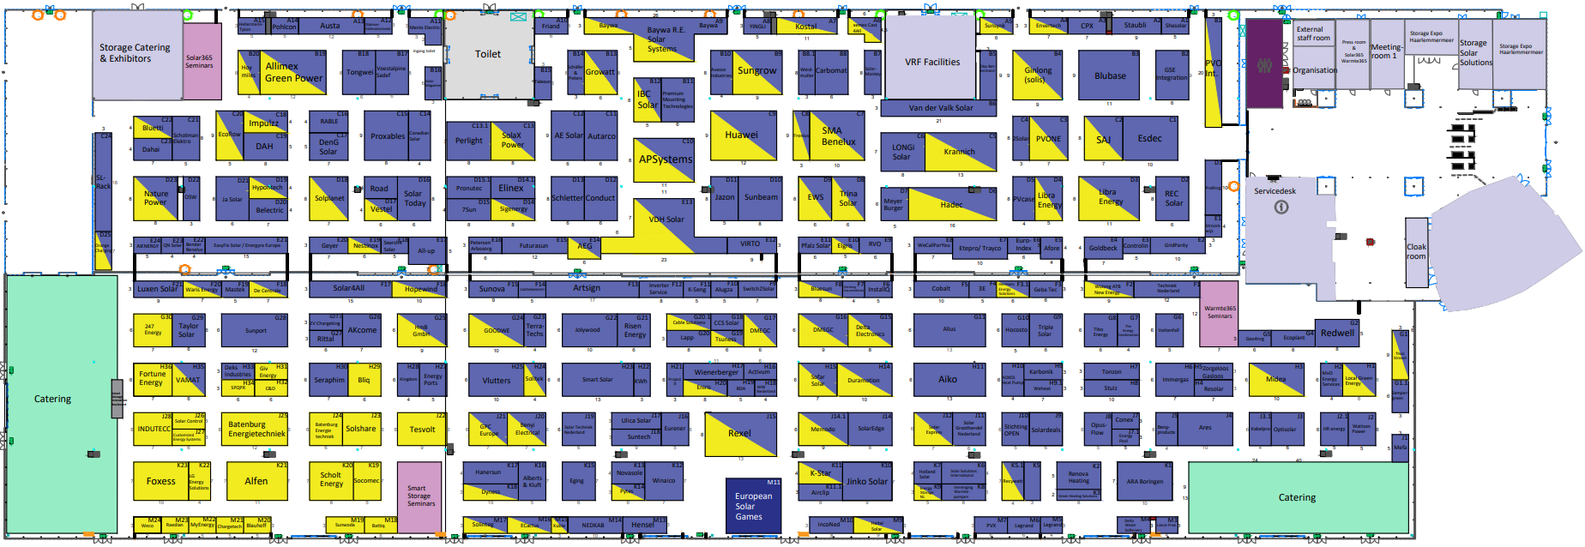
Solar Solutions Amsterdam
11th - 13th March 2025, Expo Greater Amsterdam, Vijfhuizen
2024:
More than 280 exhibitors, almost 16 000 B2B visitors
Smart Storage: 26 exhibitors + on 73 other stands
04

Slide 5
99 Smart Storage Companies at Solar Solutions Amsterdam 2024
247 Energy
3E
Activum Groen Lease
AEG
Afore
Aiko
Alfen
Alius
Allimex Green Power
APSystems
Austa
Batenburg Energietechniek
BattiQ Energieopslag
BayWa
Beny
Blauhoff
Bliq
Bluesun
Bluetti
C&D Clean Energy
Cable Solutions
Carbomat Group
CCS Solar
ChargeTech/ V2C eChargers
Customized Energy Systems
Dahai
Delta Electronics
Denim
DENIOS
Duramotion
Dyness
ECOFLOW
Elgris.nl
ELINEX Power Solutions
Energy Storage NL
EWS
Fortune Energy Distribution
FoxESS
Fronius International
GivEnergy Europe
GPC Nederland
Growatt
HADEC Duurzame Energie
Hermans Energy Solutions
HMB
Hopewind
Huawei FusionSolar
IBC Solar
Impulzz
IncoNed
Indutecc Renewable Solutions
Jazon Solar Distributie
Krannich Solar Nederland
Kstar
LG Energy Solution
Libra Energy
Local Green Energy/ Thermasol
Marstek
Memodo Nederland
Midea
MyEnergi
Naturepower
ProfiNRG
Project Zero
PVO International
PVONE
Pytes
Recywatt/ Deye
Rexel Nederland
Rittal
Scholt Energy
Search4Solar
Sigenergy Technology
SMA Benelux
Socomec
SofarSolar
Solar Express
SolarDeals
SolarEdge Technologies
SolaX
Solinteg
SoliTek
Solshare Distribution
SPQPR
Sungrow
Sunsynk
Sunwoda
Taylor Technologies
Telergon
Tesvolt
Trina Solar
Tsuness
VDH Solar
Waris Energy
WeCallForYou
WeCo
Weiheng eCactus
Wolong ATB New Energy
Xemex & CAST4ALL
05

Slide 6
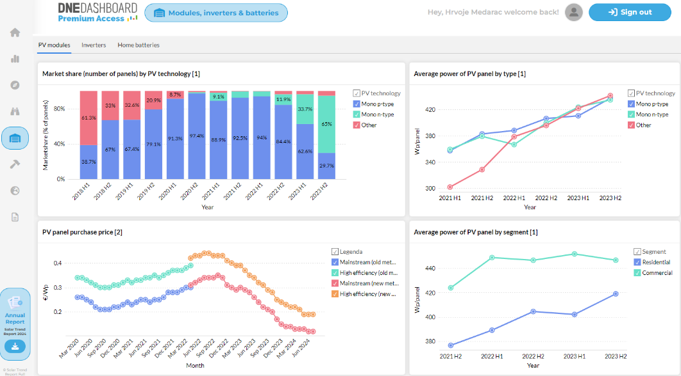
DNE Research
DNE Research
Who we are: Research team focused on the latest developments in areas of solar energy, smart storage and green heating.
What we do:
Trend reports
Data dashboard
Research support for exhibitions and 365 media platforms
06

Slide 7
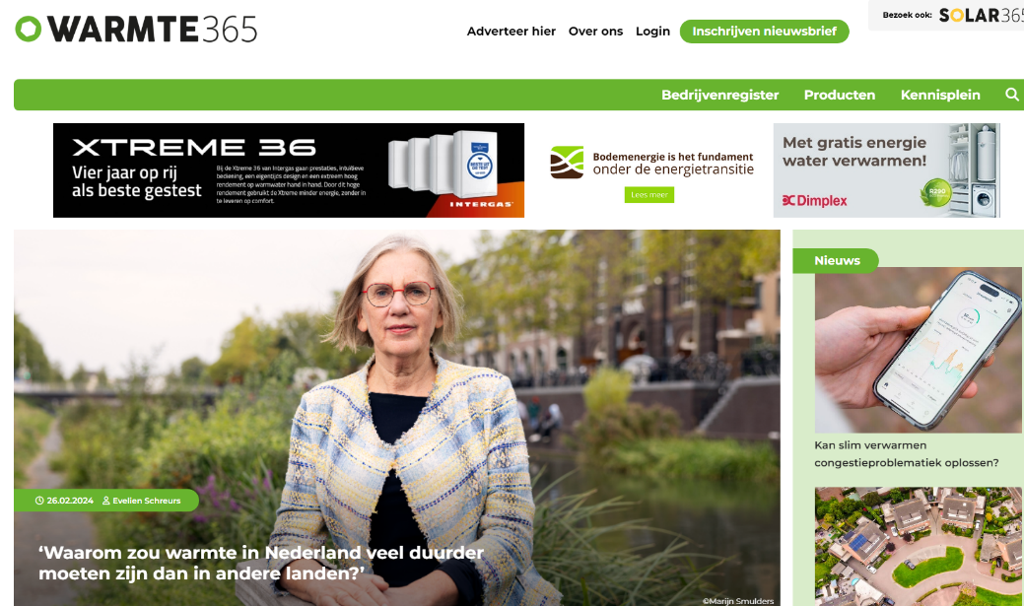
Solar en warmtepomp
Solar365.nl & Warmte365.nl
Role: Largest online media platforms for solar energy and renewable heat in The Netherlands
Coverage:
Analyses
Innovations
Interviews
Opiniating-editorials
07

Slide 8
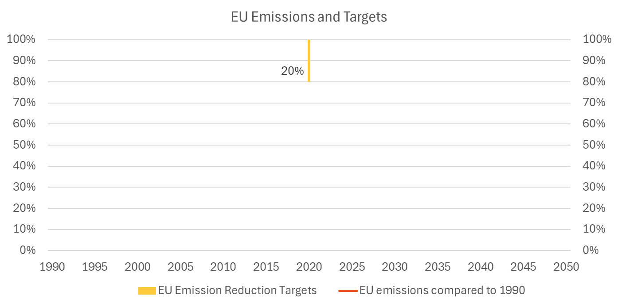
Klimaatdoel 1
EU Climate Targets (compared to 1990)
2020 target (set in 2008)
- 20% emission reductions
08
Source: European Environment Agency- EEA greenhouse gases — data viewer European Commission- Climate strategies & targets

Slide 9
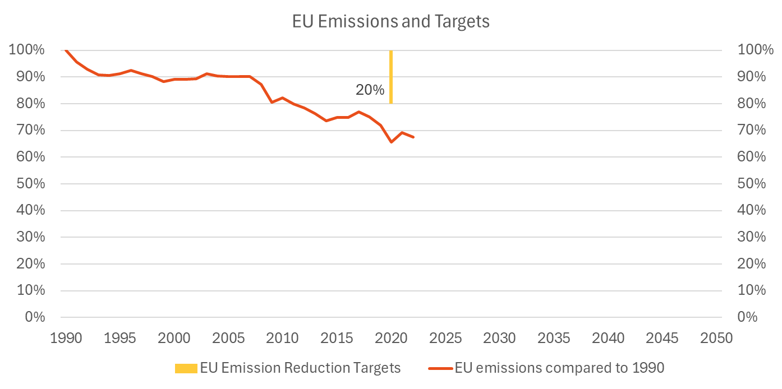
Klimaatdoel 2
EU Climate Targets (compared to 1990)
2020 target (set in 2008)
- 20% emission reductions
08
Source: European Environment Agency- EEA greenhouse gases — data viewer European Commission- Climate strategies & targets

Slide 10
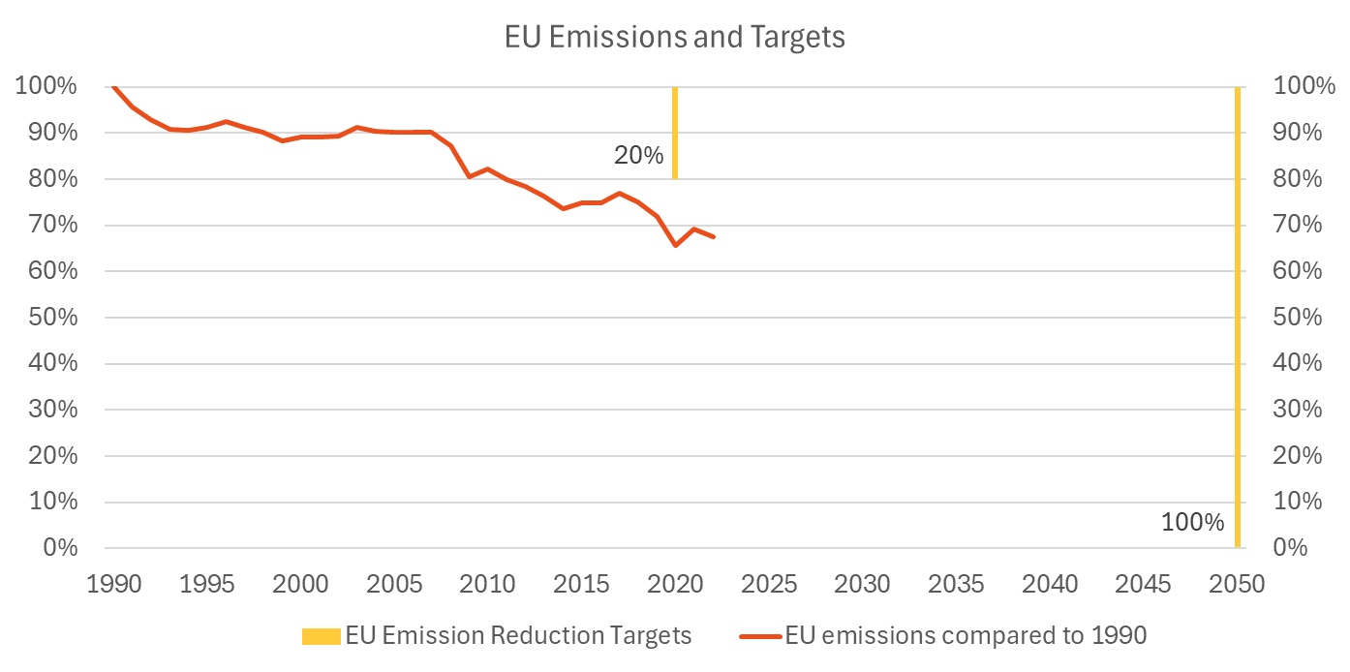
Klimaatdoel 3
EU Climate Targets (compared to 1990)
2020 target (set in 2008)
- 20% emission reductions
2050 target (set in 2019)
- Climate Neutral Continent
EU Green Deal
08
Source: European Environment Agency- EEA greenhouse gases — data viewer European Commission- Climate strategies & targets

Slide 11
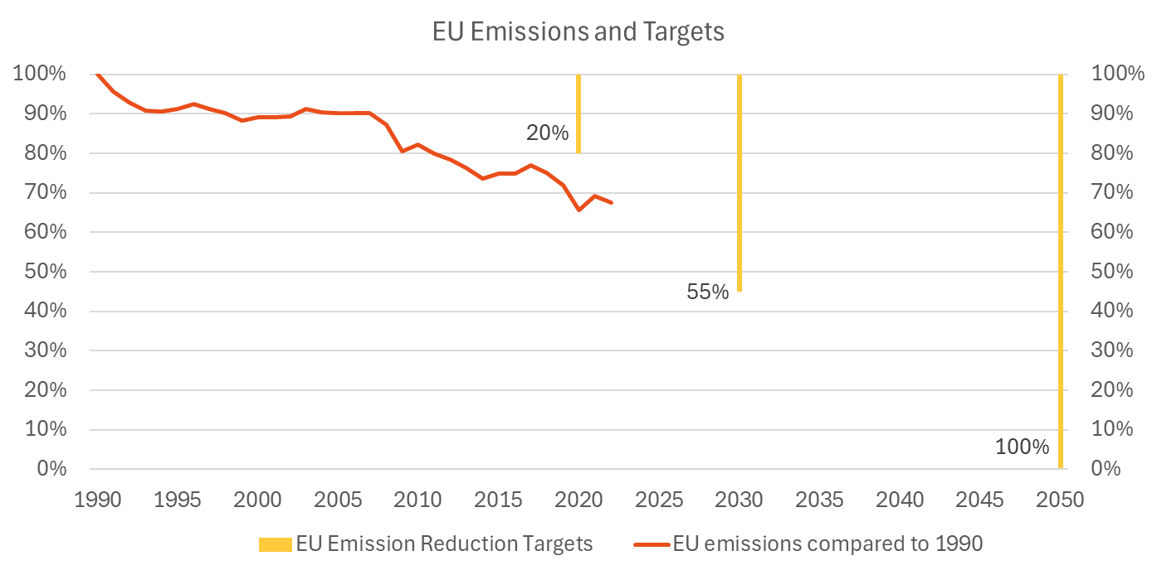
Klimaatdoel 4
EU Climate Targets (compared to 1990)
2020 target (set in 2008)
- 20% emission reductions
2030 target (set in 2020)
- 55% emission reductions
2050 target (set in 2019)
- Climate Neutral Continent
EU Green Deal
08
Source: European Environment Agency- EEA greenhouse gases — data viewer European Commission- Climate strategies & targets

Slide 12
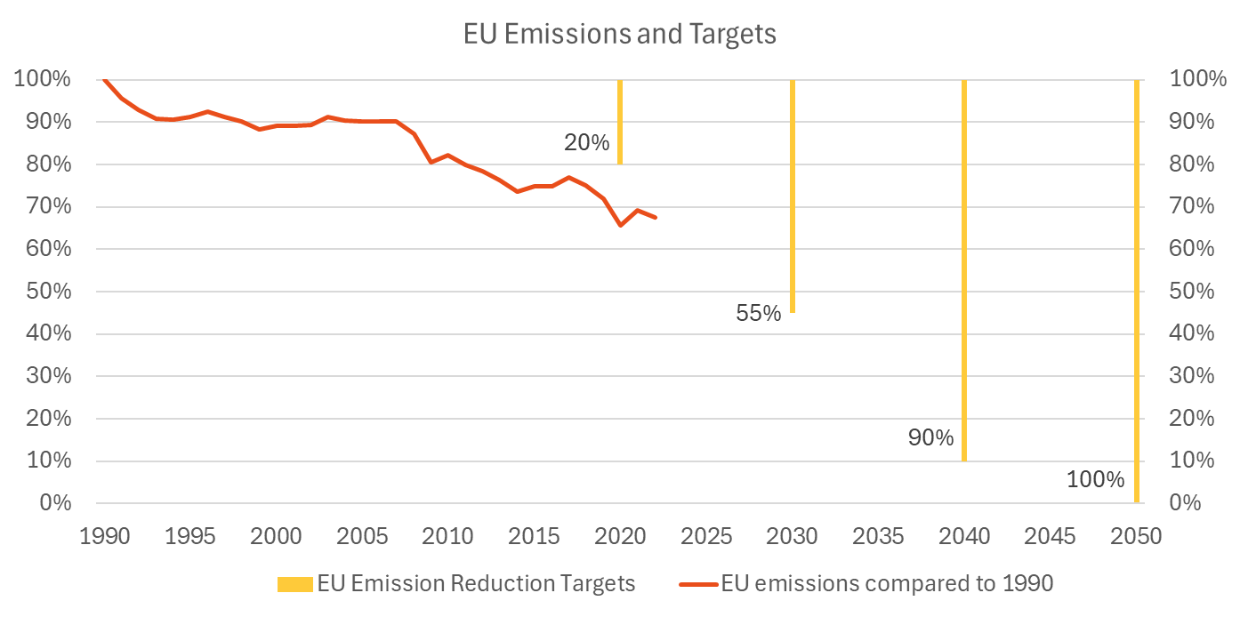
Klimaatdoel 5
EU Climate Targets (compared to 1990)
2020 target (set in 2008)
- 20% emission reductions
2030 target (set in 2020)
- 55% emission reductions
2040 EC recommendation (February 2024), repeated by Von der Leyen (July 2024)
- 90% emission reductions
2050 target (set in 2019)
- Climate Neutral Continent
EU Green Deal
08
Source: European Environment Agency- EEA greenhouse gases — data viewer European Commission- Climate strategies & targets

Slide 13
EU beleid
Energy policy in European Union
2030 Targets
-11,7% energy use
42,5% renewables
2040 Targets
-80% fossil fuels
Reference scenario
Energy savings
11,7%
RES
42,5% RES
RES and Nuclear
80% less
Source: Eurostat- Simplified energy balances
European Commission- Climate strategies & targets
European Commission- Energy efficiency- targets, directive and rules
European Commission- Renewable energy- targets, directive and rules
09

Slide 14
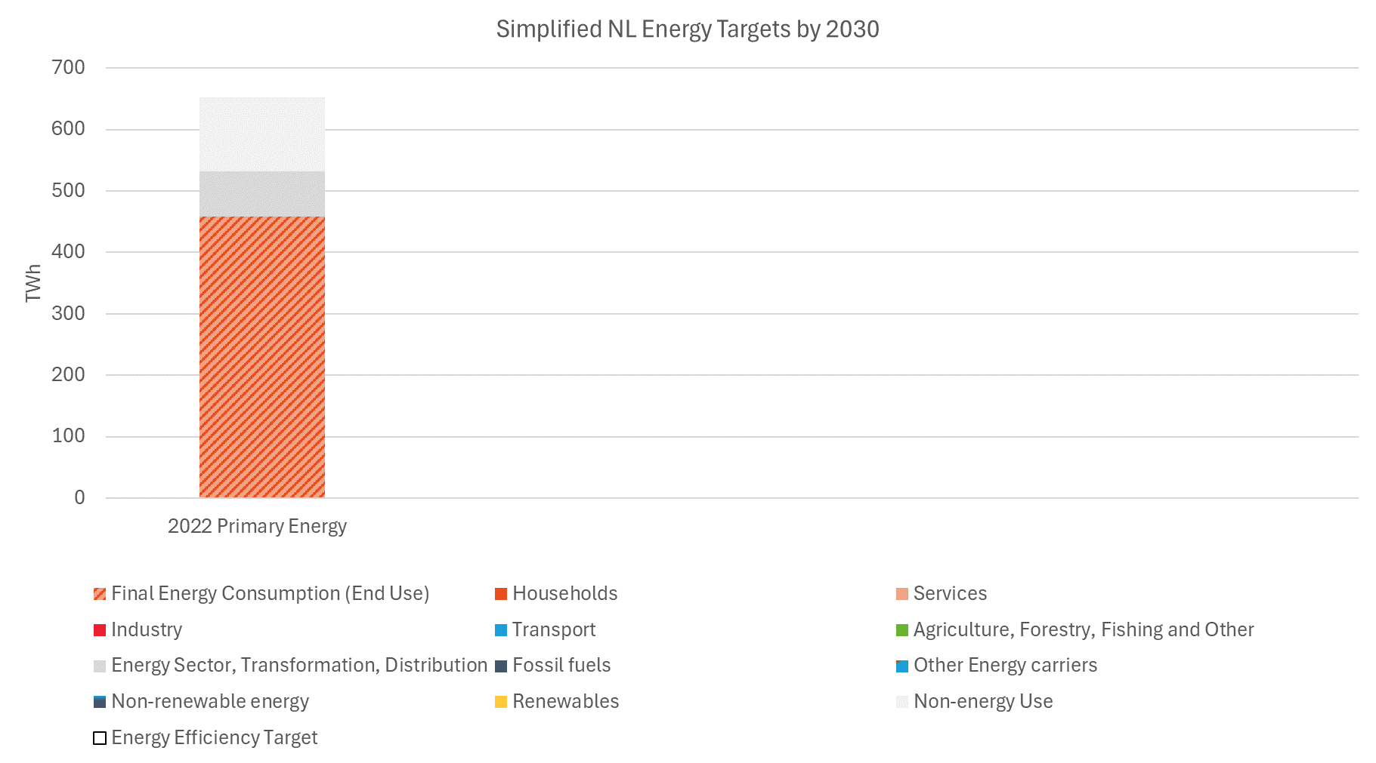
Energie doel
NL Energy Targets
2022 Primary Energy Use
- 70% End Use
Fossil
10
Source: Eurostat- Simplified energy balances
Dutch National Energy and Climate Plan (NECP)

Slide 15
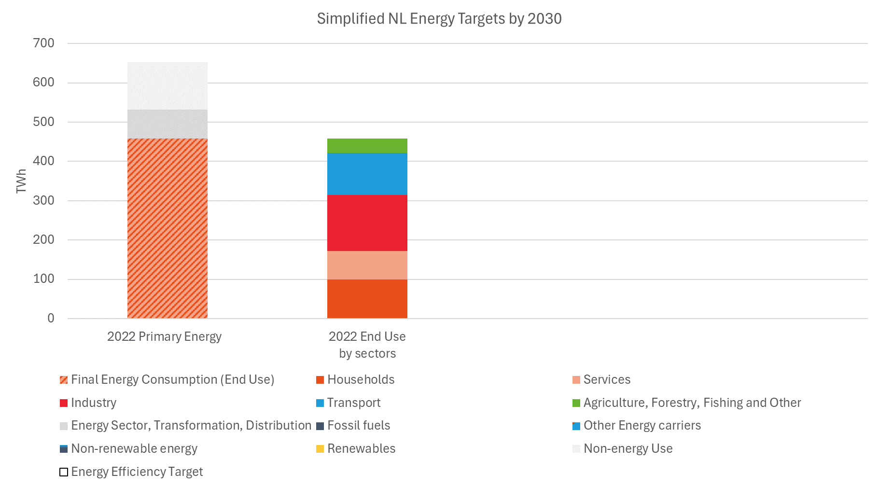
Energie doel 2
NL Energy Targets
2022 Primary Energy Use
- 70% End Use
2022 End Use by sectors
~ 70% in households, services and industry
Commercial
Room for Storage?
Fossil
Residential
10
Source: Eurostat- Simplified energy balances
Dutch National Energy and Climate Plan (NECP)

Slide 16
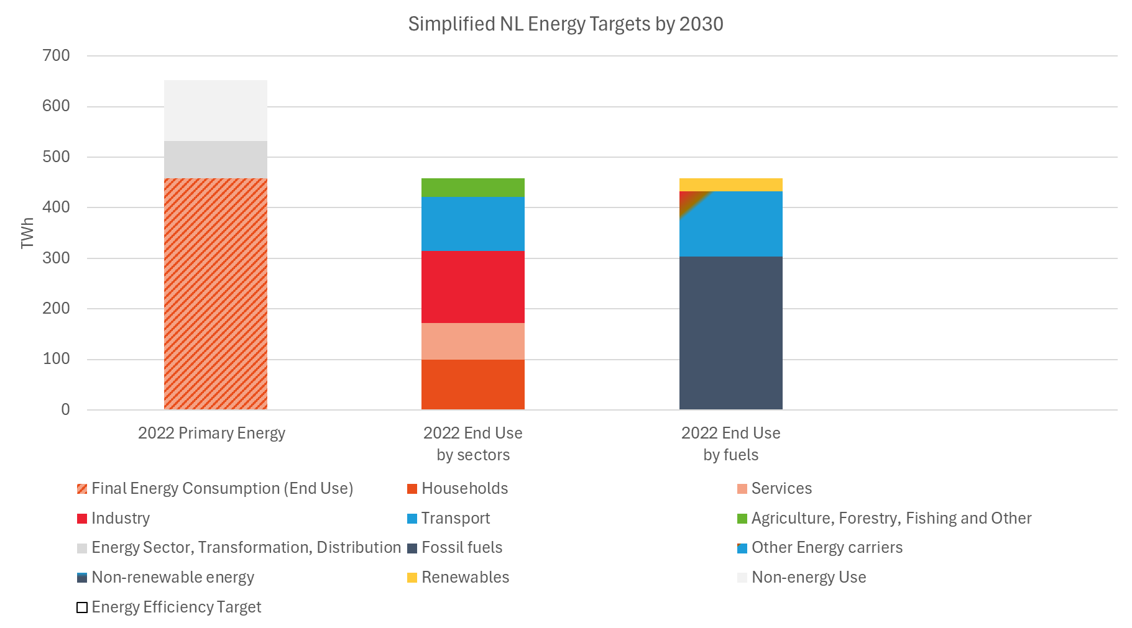
Energie doel 3
NL Energy Targets
2022 Primary Energy Use
- 70% End Use
2022 End Use by sectors
~ 70% in households, services and industry
2022 End Use by fuels
- 5,5% Renewables (Eurostat- balances) (15% RES share- Eurostat, methodology)
Reference scenario
RES
Room for Storage?
Commercial
Fossil
Residential
10
Source: Eurostat- Simplified energy balances
Dutch National Energy and Climate Plan (NECP)

Slide 17
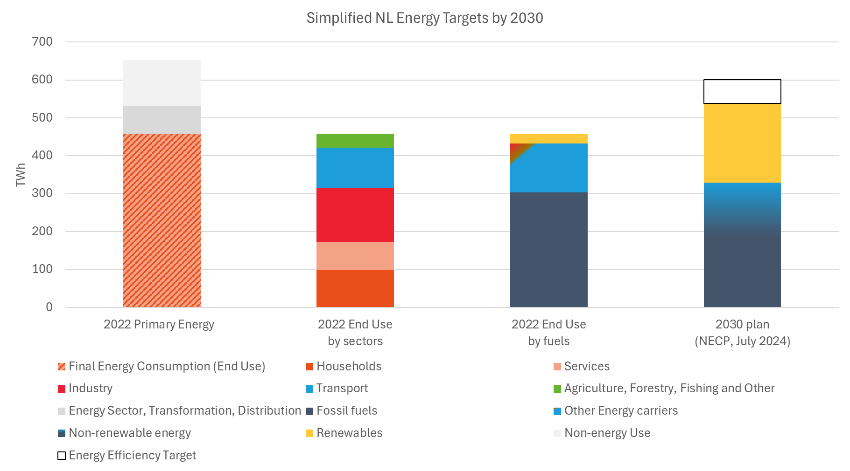
Energie doel 4
NL Energy Targets
2022 Primary Energy Use
- 70% End Use
2022 End Use by sectors
~ 70% in households, services and industry
2022 End Use by fuels
- 5,5% Renewables (Eurostat- balances) (15% RES share- Eurostat, methodology)
2030 Targets
- 11,7% Energy Savings compared to 2021 reference scenario
- 38,8% Renewables
Reference scenario
Energy savings
11,7%
RES
38,8% RES
Commercial
Room for Storage?
Fossil
Residential
10
Source: Eurostat- Simplified energy balances
Dutch National Energy and Climate Plan (NECP)

Slide 18
Beleid tijdijn
Battery Storage policy Timeline
2020
05/2022
04/2023
05/2024
09/2024
2020
2022
2024
2026
2028
2030
2034
2035
2032
2021
2023
2025
2027
2029
2031
2032
2023: gradual decrease of the net-metering scheme
2025: gradual decrease of the net-metering scheme moved to ‘25
2035: climate neutral electricity sector (NL)
2025: abandoning of gradual decrease of the net-metering scheme
2027: stopping the net-metering scheme
2025: Pilot project- battery obligation for subsidised solar parks (€100M grant + €172M reserved)
11

Slide 19
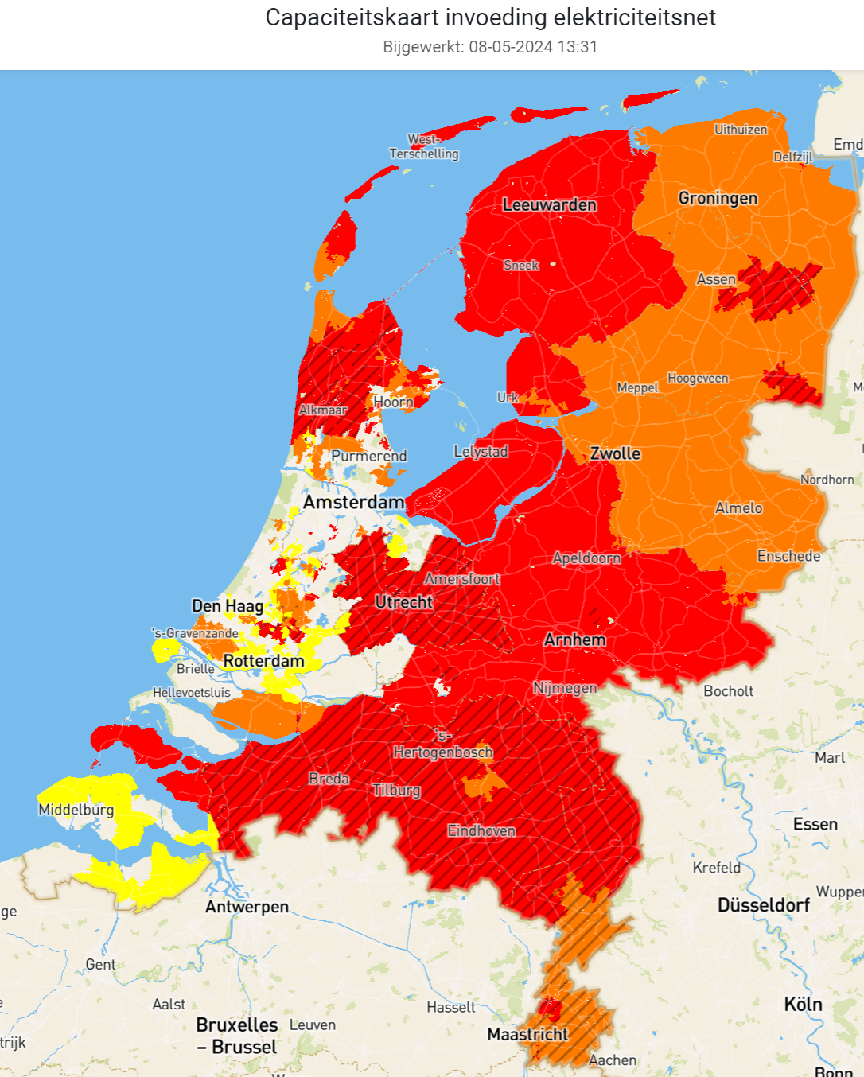
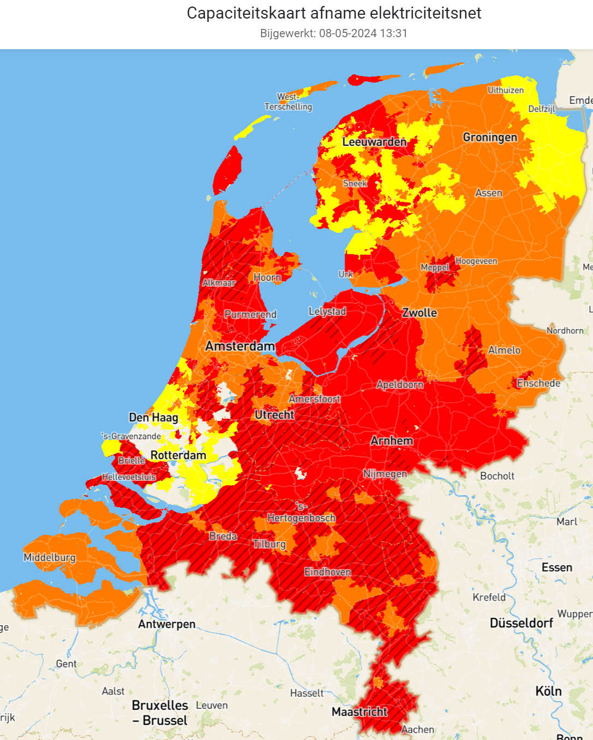
Net congestion problems
12
Source: netbeheernederland.nl

Slide 20
European policy
European Green Deal
Circular economy action plan
Battery Regulation & Ecodesign for Sustainable Products Regulation
Directive on repair of goods?
13

Slide 21
Battery Regulation
CO₂-footprint (CO₂ footprint declaration and performance class)
Percentage recycled material (share of cobalt, lead, lithium and nickel)
Performance and sustainable demands (loss of capacity, loss of performance, expected lifetime and so on)
Safety demands (thermal shock alternating test, external security against short circuit, overload protection and so on)
Information duty (software reset, current data on the condition, the expected lifetime and so on)
Return and collection (recycling system)
14

Slide 22
Ecodesign for Sustainable Products Regulation
Digital Product Passport via QR-code (>2 kilowatt hour)
Battery model
Technical performance
Used materials
Percentages of used recycled materials
Origin of used materials
Repair activities
Recycling options
Environmental-impact during lifetime cycle
Recycled? > passport expires
Reuse, repurposing or remanufacturing? > new passport with a link to the old passport
15

Slide 23
Smart Storage Trend Report 24/25
Dutch New Energy Research team
numbers
Solar365 team
text
16

Slide 24
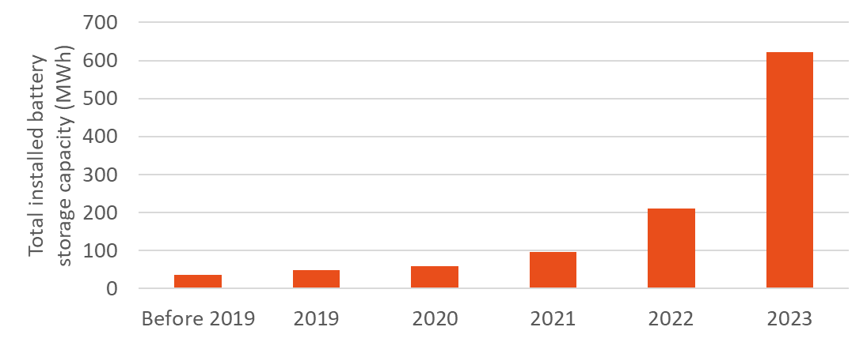
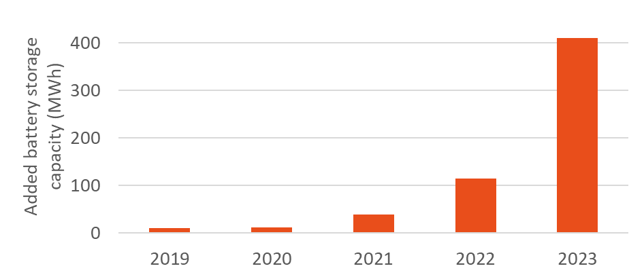
Total installed battery storage capacity
Total installed
621 MWh in 2023
100% - 200% annual growth since 2020
Annual added cappacity
410 MWh in 2023
200% - 250% annual growth since 2020
2/3
3,6x
3x
3,5x
17
Source: DNE Research
Energy Storage NL

Slide 25
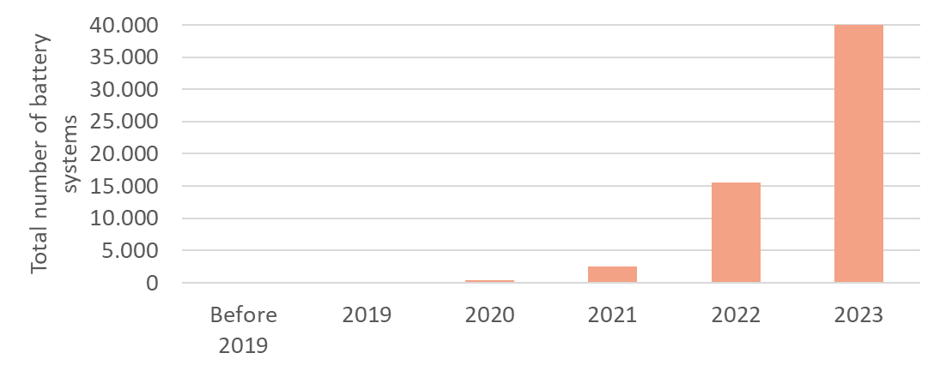
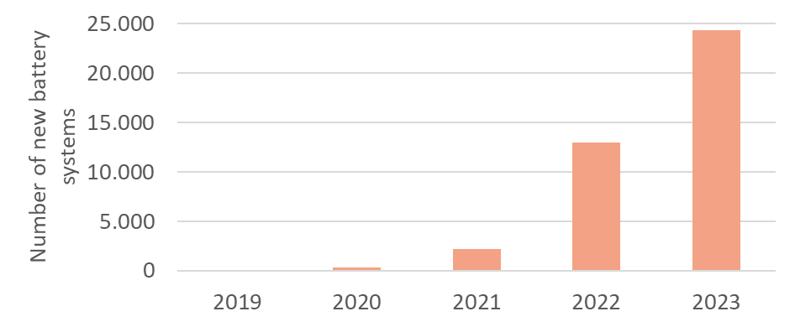
Totaal aantal batterij energieopslagsystemen
Total number of battery storage systems
Total installed
40.000 installed battery systems by 2023
150% growth in 2023
Annual sales
24.400 sold battery systems in 2023
5 digit sales from 2022
18
Source: DNE Research
Energy Storage NL

Slide 26
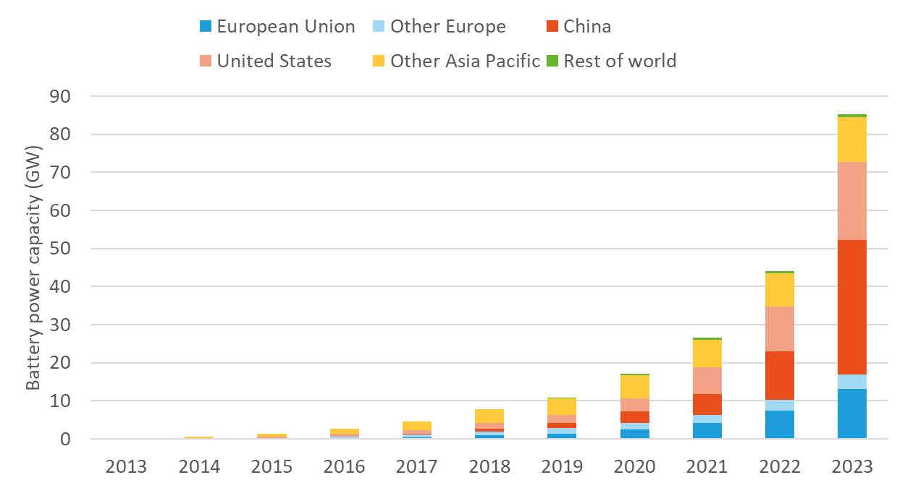
Global perspective - total battery power capacities
86 GW of installed battery systems by 2023
At least 50% growth since 2019
35 GW in China (41%)
13 GW in EU (15%)
94%
66%
56%
57%
19
Source: IEA

Slide 27
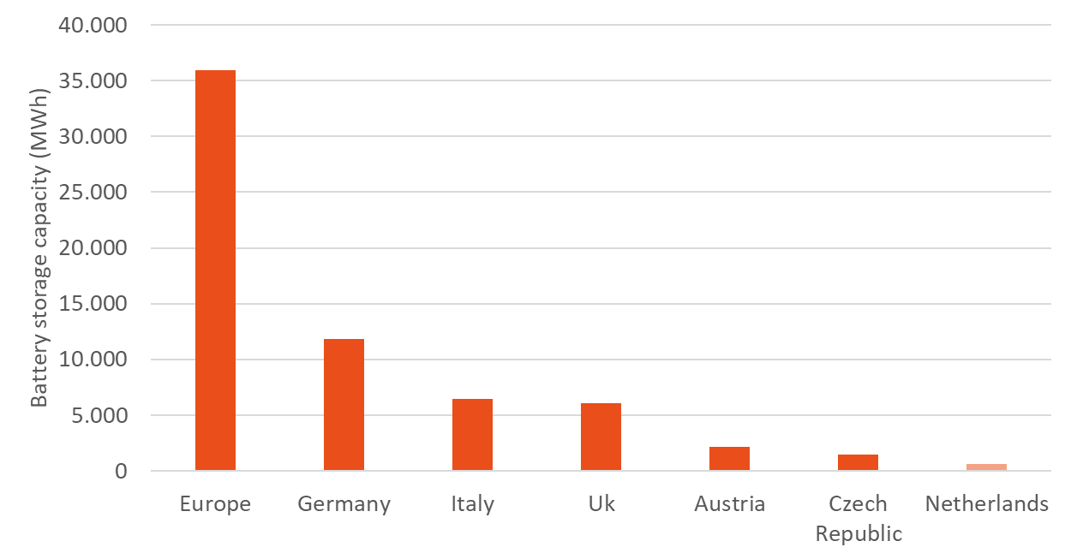
European perspective- total storage capacities
36 GWh by 2023 in Europe
DE: 12 GWh (33%)
IT: 6,5 GWh (18%)
UK: 6 GWh (17%)
AT: 2 GWh (6%)
CZ: 1,4 GWh (4%)
NL: 0,6 GWh (1,7%)
20
Source: European Market Outlook for Battery Storage 2024-2028
DNE Research

Slide 28
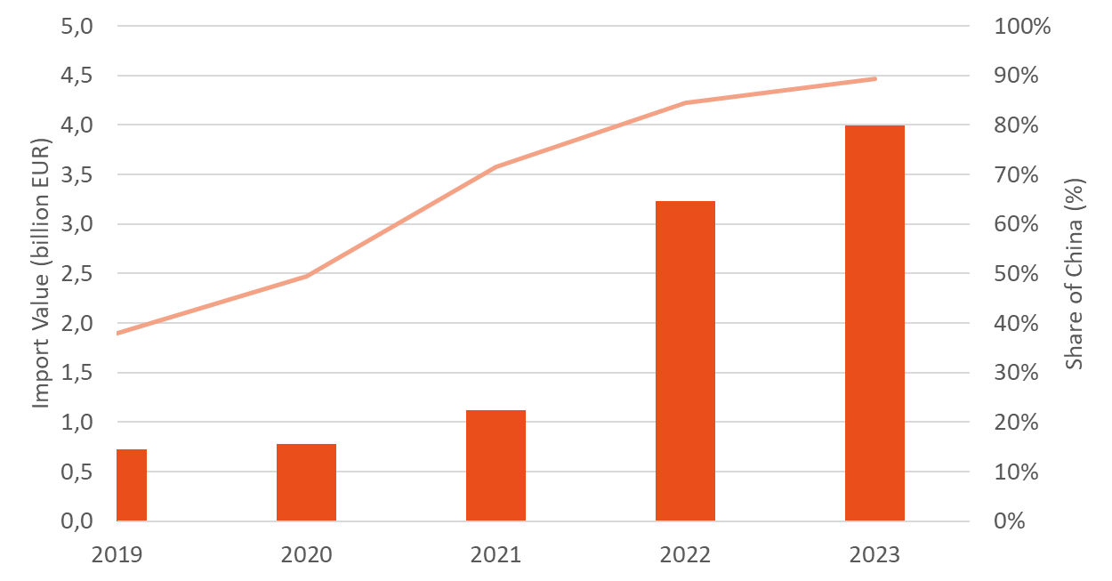
Imports through The Netherlands
4 billion EUR in 2023
(equivalent to 80% of total capacities in EU*)
90% imports from China
2023 imports from China are equivalent to 70% of total EU battery capacities
21
*Assumption: global trading battery storage price is 140 EUR/kWh (BNEF)
Source: Dutch customs office

Slide 29
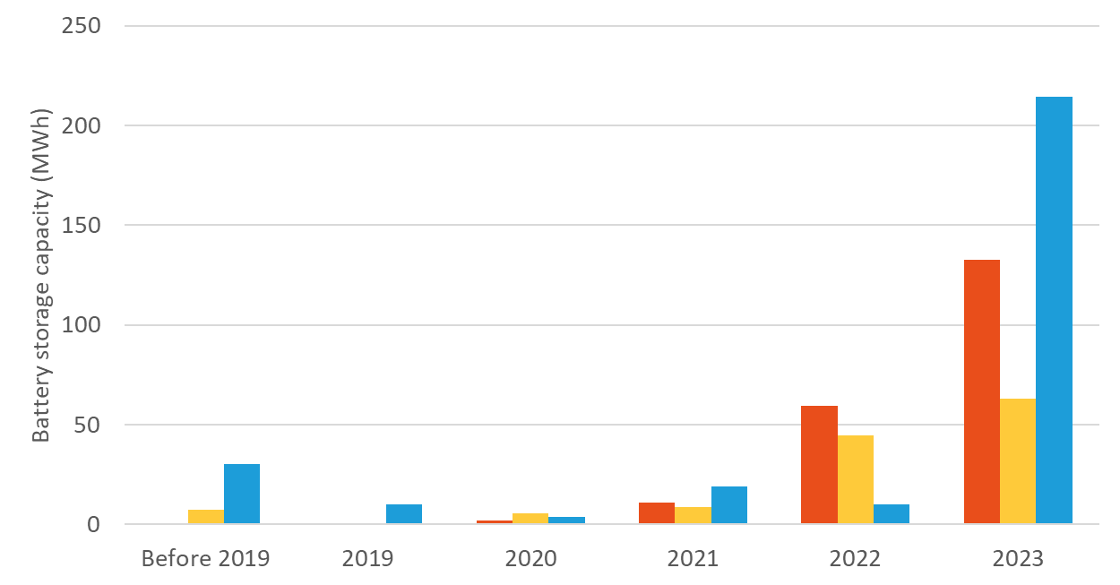
Sectoral analysis- added capacities
Before 2020
limited investments
only utility (and commercial)
More interest
2020- residential
2022- commercial
2023- utility
2023 sales:
133 MWh residential
63 MWh commercial
215 MWh utility scale
22
Source: DNE Research
Energy Storage NL

Slide 30
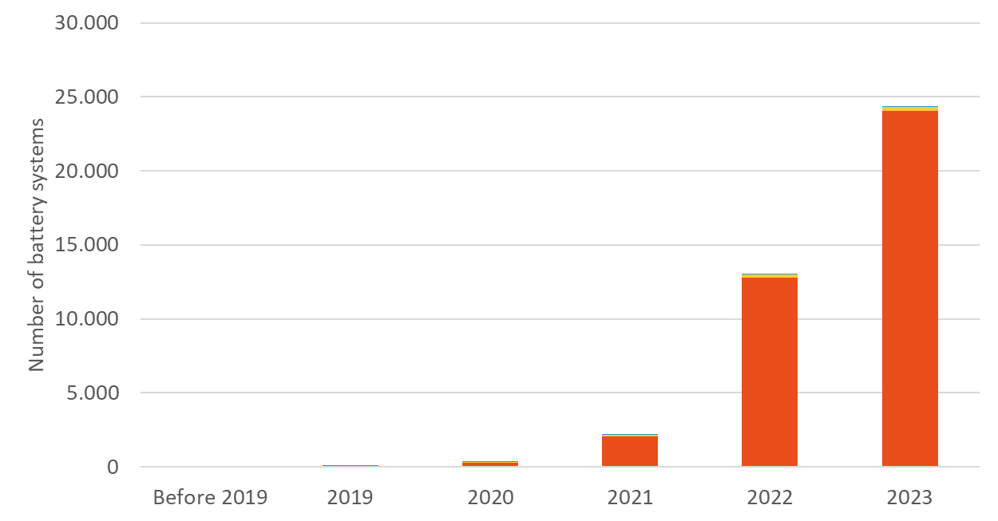
Sectoral analysis- annual sales in numbers
Residential sector dominant!
2023 sales:
24.000 residential
280 commercial
60 utility scale
23
Source: DNE Research
Energy Storage NL

Slide 31
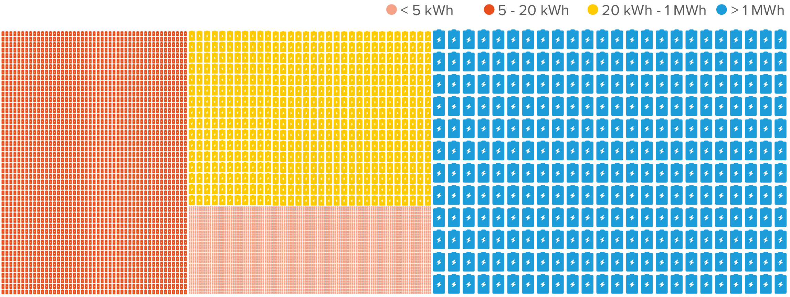
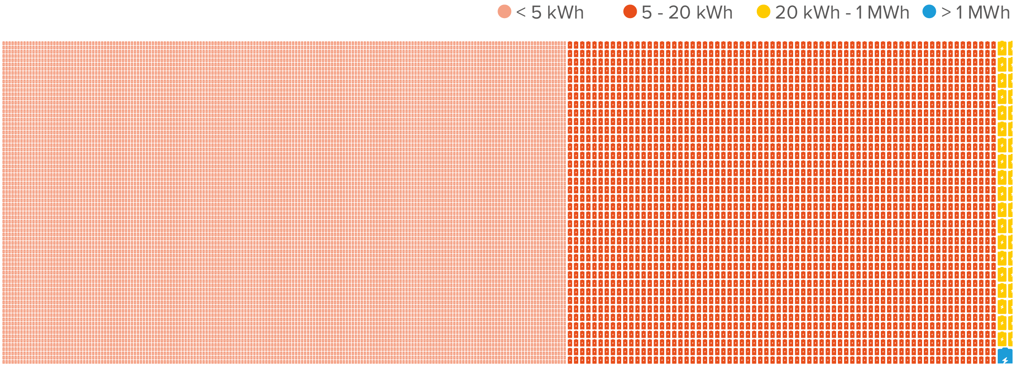
Overview of total battery storage in 2023
Capacity (621 MWh):
Small residential: 63 MWh (10%)
Large residential: 142 MWh (23%)
Commercial: 129 MWh (21%)
Utility: 287 MWh (46%)
Number of batteries:
Small residential: 22.500 (56%)
Large residential: 16.700 (42%)
Commercial: 700 (1,8%)
Utility: 76 (0,2%)
24
Source: DNE Research
Energy Storage NL

Slide 32
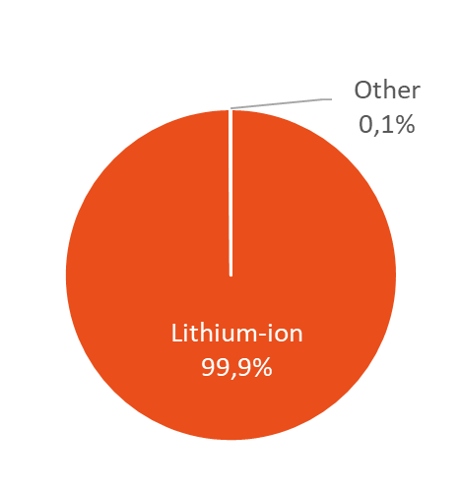
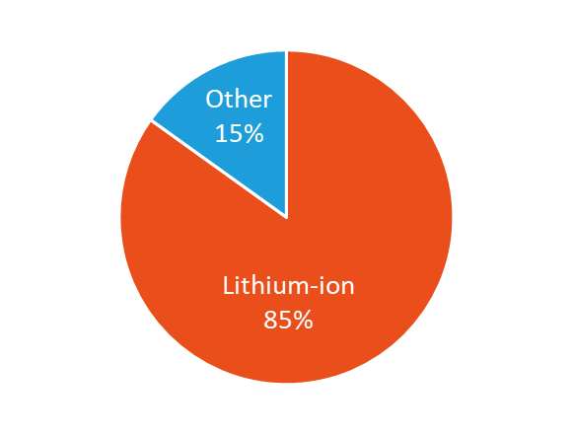
Battery types sold in 2023
Numbers shares:
Li-ion: 99,9%
Other (Absorbent Glass Mat Lead Acid (AGM), Vanadium Redox Flow Batteries (VRFB) and Supercapacitors): 0,1%
Capacity shares:
Li-ion: 85%
Other (Absorbent Glass Mat Lead Acid (AGM), Vanadium Redox Flow Batteries (VRFB) and Supercapacitors): 15%
Li-ion- mainly residential sector
Other- mainly utility sector
25
Source: DNE Research
Energy Storage NL

Slide 33
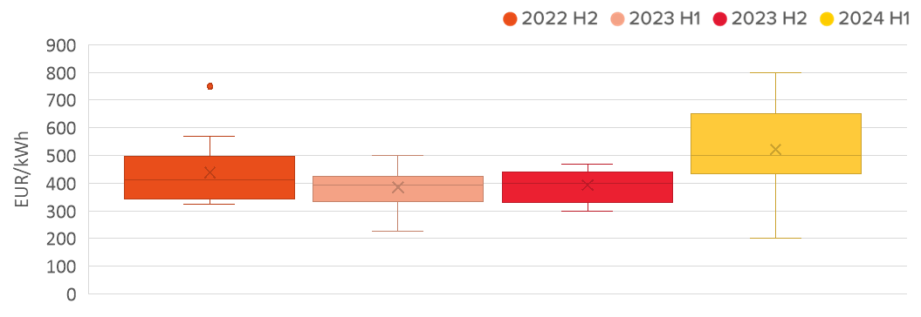
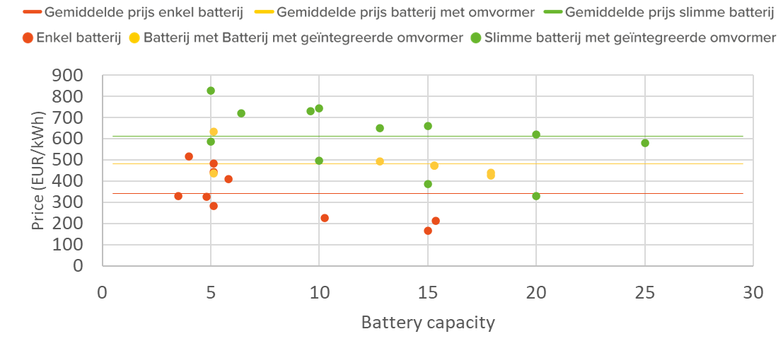
Battery prices in 2023
Decrease until 2023, but wider range in 2024
Different prices based on equipment
Provisional price ranges:
Only battery
~ 300-400 EUR/kWh
Battery with integrated inverter
~ 450-500 EUR/kWh
Smart battery
~ 550-750 EUR/kWh
26
Source: DNE Research
Web shops for batteries

Slide 34
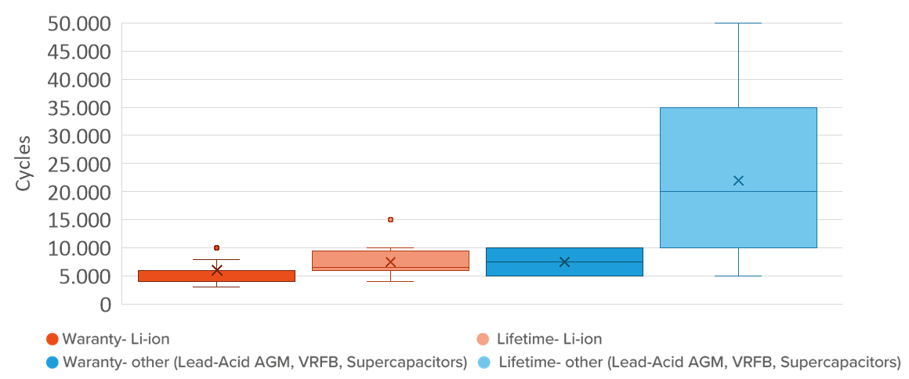
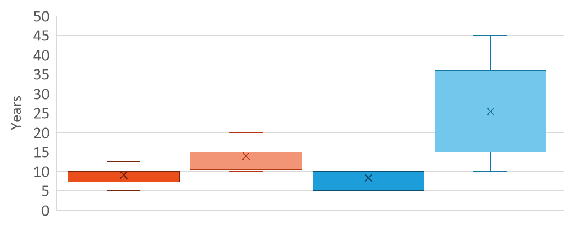
Warranty and Expected lifetime
Li-ion
Warranty
4.000 - 6.000 cycles (7,5 - 10 years)
Expected lifetime
6.000 – 9.500 cycles (10 – 20 years)
Other
Warranty
5.000 - 10.000 cycles (5 – 10 years)
Expected lifetime
5.000 – 50.000 cycles (10 – 45 years)
27
Source: DNE Research

Slide 35
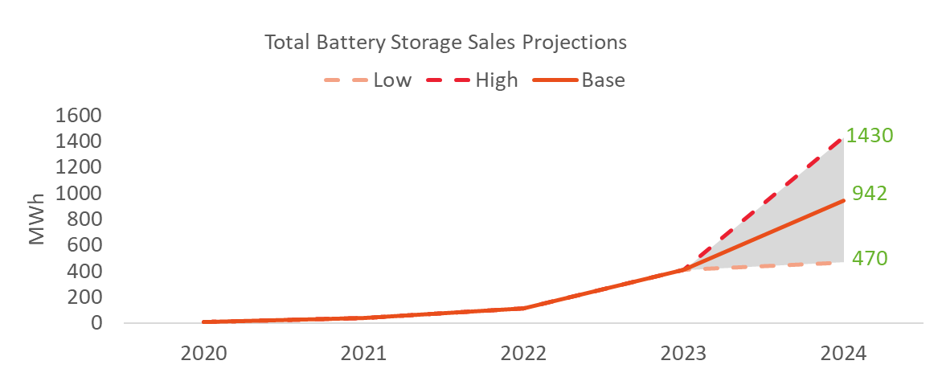
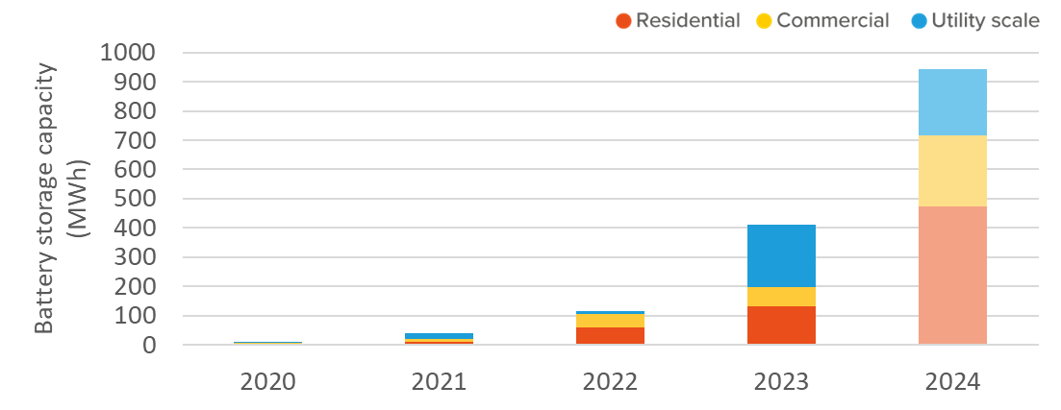
2024 voorspelling
2024 projections
Base scenario
reported values from the research
High and Low scenarios
market trends
Base scenario sales projections
for 2024:
Residential sector: 472 MWh
Commercial sector: 246 MWh
Utility sector: 224 MWh
28
Source: DNE Research

Slide 36
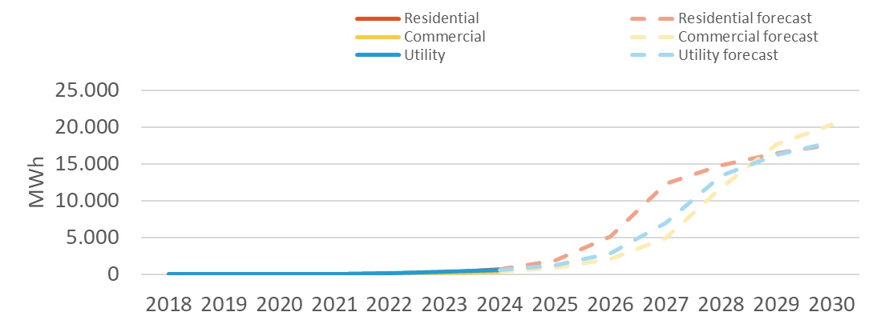
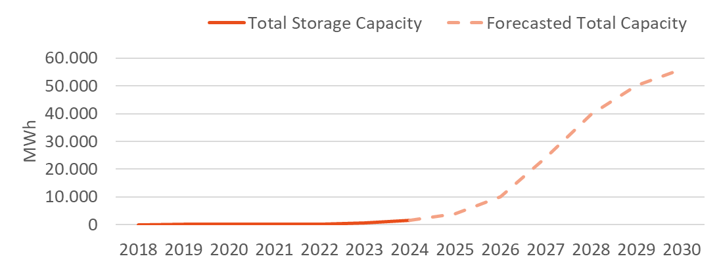
Longterm forecast- total capacities
Methodology:
Residential and commercial sectors
Market trends
Limit based on - total solar capacities - 1h storage
Utility sector
Market trends
Limit based on - Tennet’s plans - 2h storage
Possible total capacity in 2030:
55 GWh
29
Source: DNE Research

Slide 37
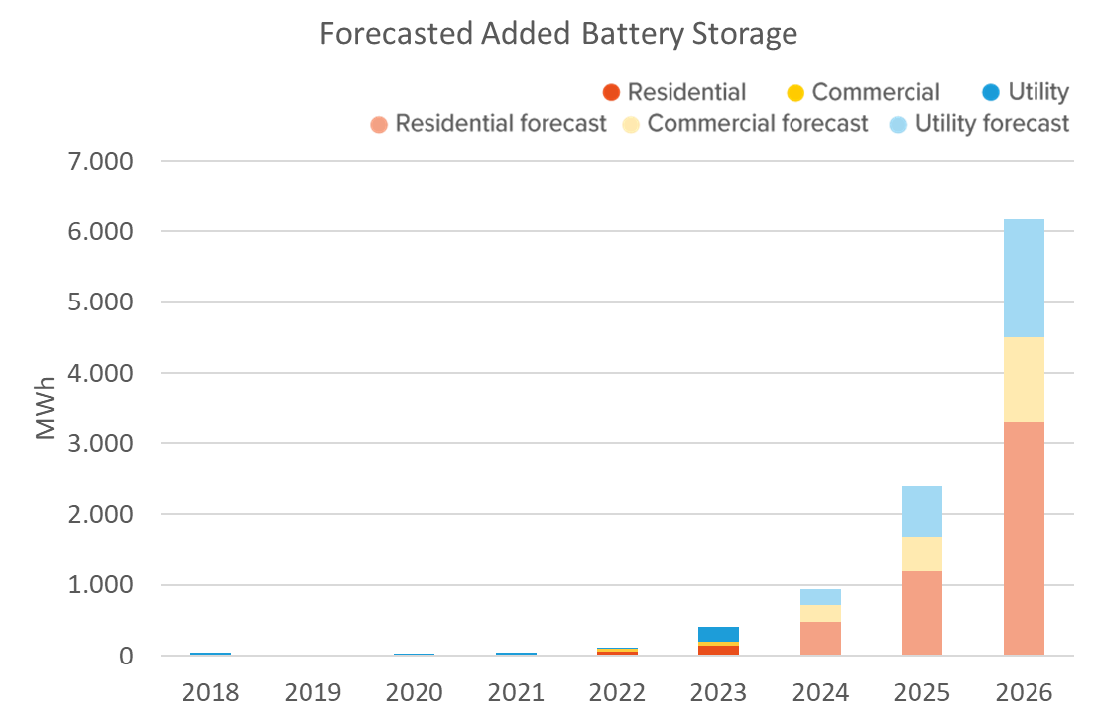
Possible closer future?
Following current market trends:
Sales forecast for 2025:
Residential sector: 1200 MWh
Commercial sector: 500 MWh
Utility sector: 700 MWh
Sales forecast for 2026:
Residential sector: 3300 MWh
Commercial sector: 1200 MWh
Utility sector: 1700 MWh
30
Source: DNE Research

Slide 38
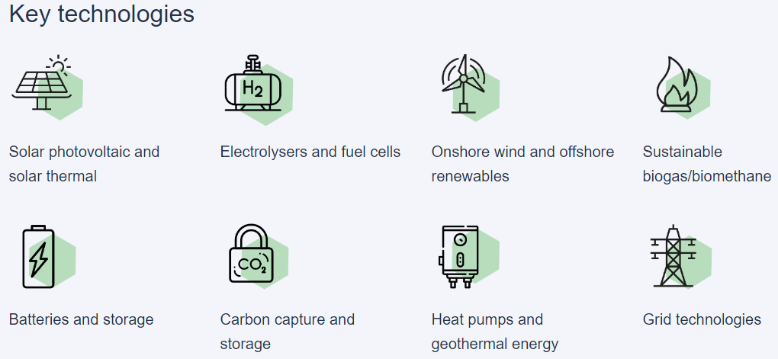
Net-Zero Industry Act (June 2024)
By 2030, EU should produce at least 40 % of the EU's annual deployment needs for eight strategic net-zero technologies!
Targets:
Batteries:
90% of EU annual demand or
550 GWh of battery manufacturing capacities
31

Slide 39
Volgende congres: Warmtepomp
Doorbraak van de Warmtepomp
The heat pumps event that shouldn’t be missed in 2024!
Our next congress: Doorbraak van de Warmtepomp
Program:
DNE Research presenting Het Nationaal Warmtepomp Trendrapport 24/25
High level speakers from heat pumps sector
Panel discussions
13 november
2024,
Louwman Museum,
Den Haag
32

Slide 40
Volgende congres: Zon
Our next congress: Toekomst van Solar
Program:
DNE Research presenting Het Nationaal Solar Trendrapport 2025
High level speakers from solar sector
Panel discussions
12 februari
2025,
Louwman Museum,
Den Haag
33

Slide 41
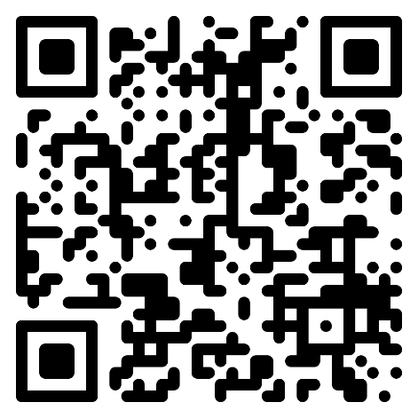
QR Code
^{Join us at}
^{one of our}
^{future events!}

